Slide 1




Slide 2
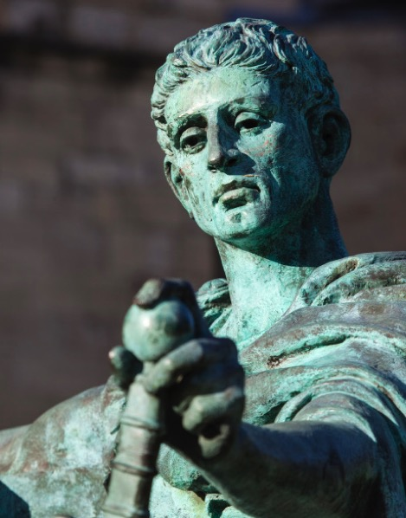
Constantine (272-337)
Constantine is best known as the first Christian Roman emperor.
He brought together the Christian faith and the secular state
Under his direction, Christianity became the official religion

Slide 3
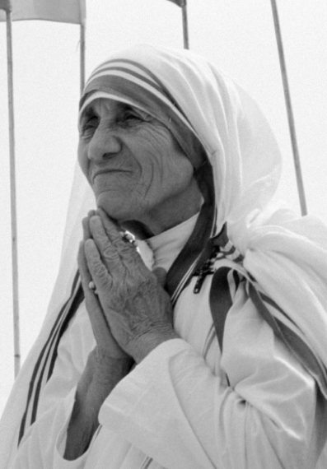
Mother Teresa (1910-1997)
Mother Teresa was an Albanian-Indian Roman Catholic nun.
In 1950, she founded the Missionaries of Charity, a Roman Catholic religious congregation in Calcutta India, dedicated to helping the ‘the poorest of the poor’.
Her life-long devotion to the care of the poor and the sick is revered all over the world still today.

Slide 4

Diggers
This was a revolutionary movement which emerged in England in the 1640s and 50s, involving such figures as Gerrard Winstanley. Its vision was both to improve the lot of the hungry and landless by cultivating common land, and
also to create a property-less and money-less society. Diggers said the earth is for all to share so should not be bought and sold. They took direct action to support their political aims and argued their case from Scripture. They were very impatient with the failure of the Church to support them. In the end they were quickly suppressed.

Slide 5
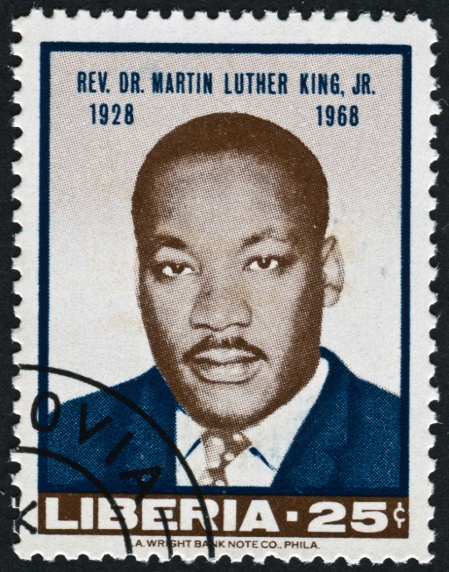
Martin Luther King Jr (1929-1968)
King was a Baptist pastor in the USA who became a leader of the civil rights movement, seeking an end to racial segregation.
Though a leader of acts of civil disobedience, such as a bus boycott, he was committed to nonviolence
He was assassinated shortly after his famous speech, ‘I have a dream’.

Slide 6
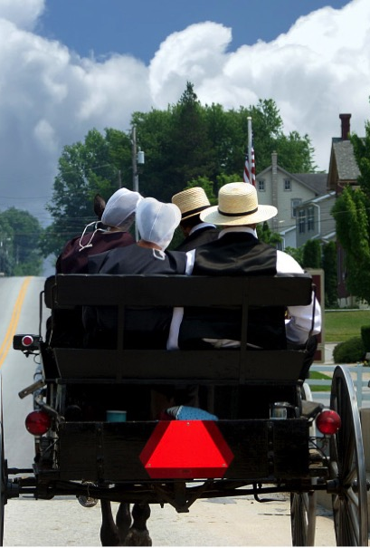
Amish Communities
The Amish people live in communities in the USA and Canada, and have roots in the Anabaptist and Mennonite traditions.
Many of them live very simply and refuse many of the benefits of modern technology
Their commitment is to model an alternative way of discipleship living that keeps them apart from the rest of society.

Slide 7
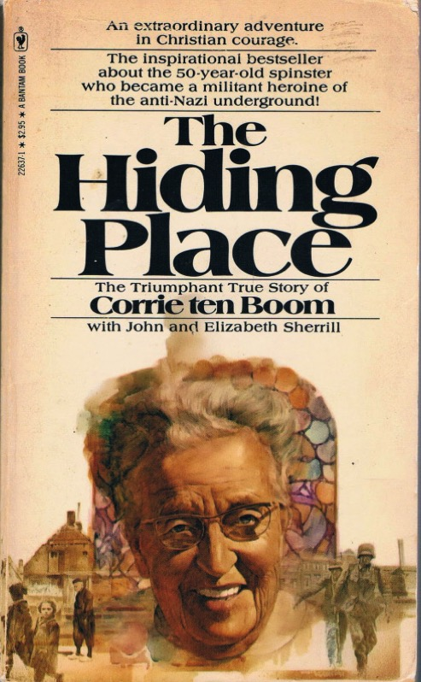
Corrie Ten Boom (1892-1983)
Ten Boom was a Dutch watchmaker and Christian who helped many Jews escape the Nazi Holocaust during World War II.
She was arrested by the Nazis in 1944 and sent to Ravensbruck concentration camp but released due to a clerical error.
After the war, Ten Boom travelled the world as a public speaker.

Slide 8
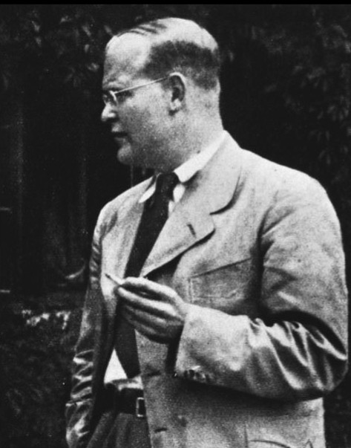
Dietrich Bonhoeffer (1906-1945)
Bonhoeffer grew up in Germany.
As a pastor and theologian, he grappled with how, as a Christian,
he should respond to the rise of Nazism.
After much heart searching, he participated in a plot to kill Hitler,
and was eventually imprisoned
and executed.

Slide 9
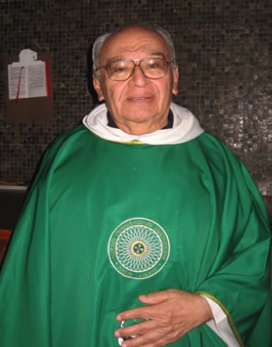
Gustavo Gutierrez (born 1928)
A Dominican priest, Gutierrez is from Peru and is described as a liberation theologian.
He has lived and worked amongst the slum people of Lima.
He believes that his Christian faith calls us to work to revolutionise the social and political structures in our world.

