Slide 1



Slide 2

Which of these headlines is fake?
One of the following headlines about climate change is fake!
Can you guess which one?

Slide 3
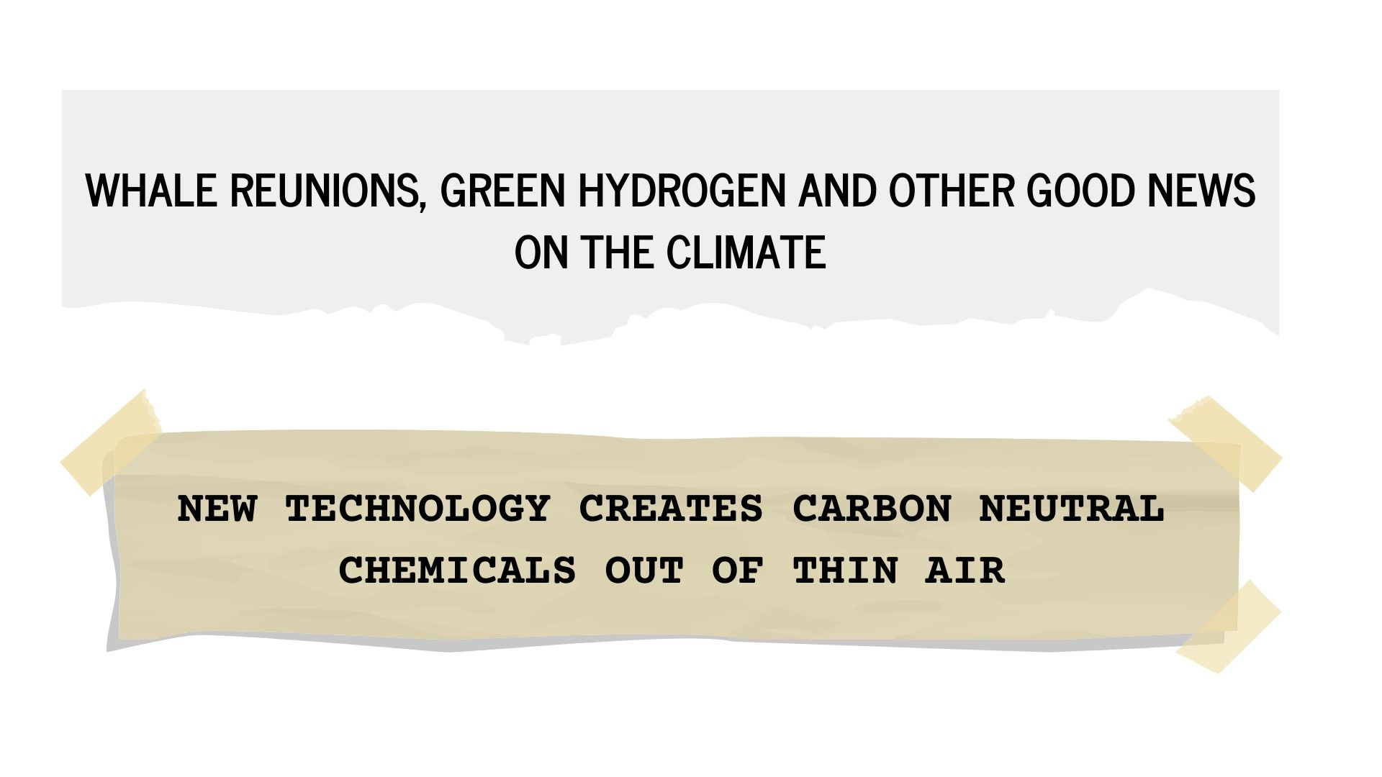
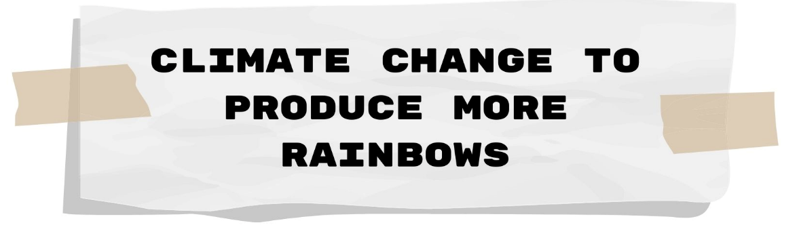
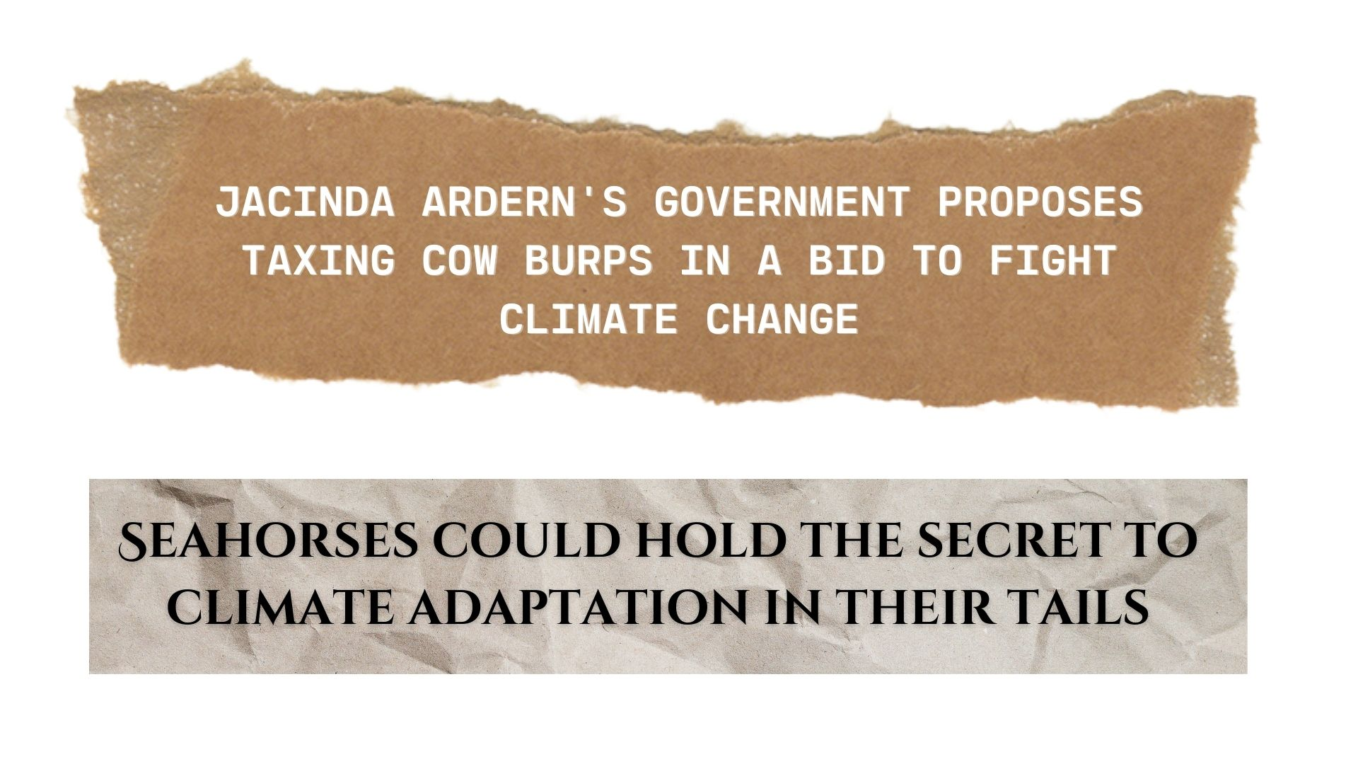



Slide 5
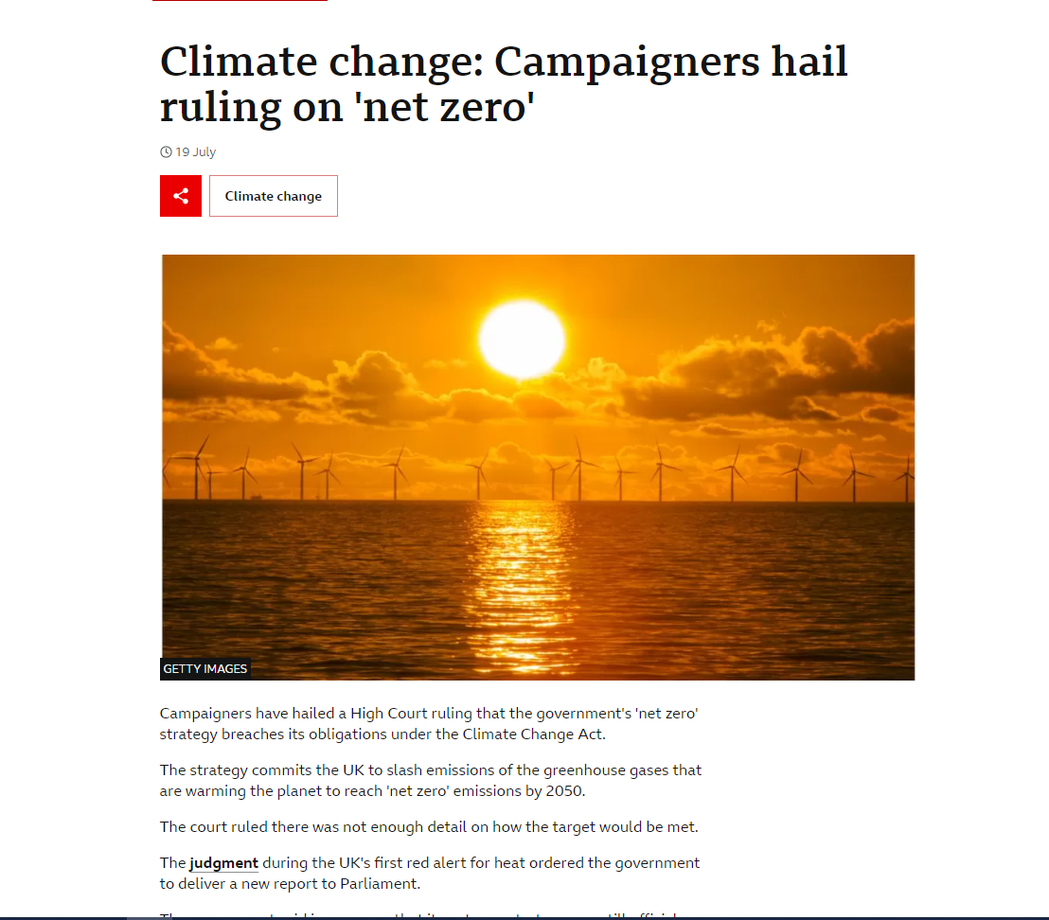
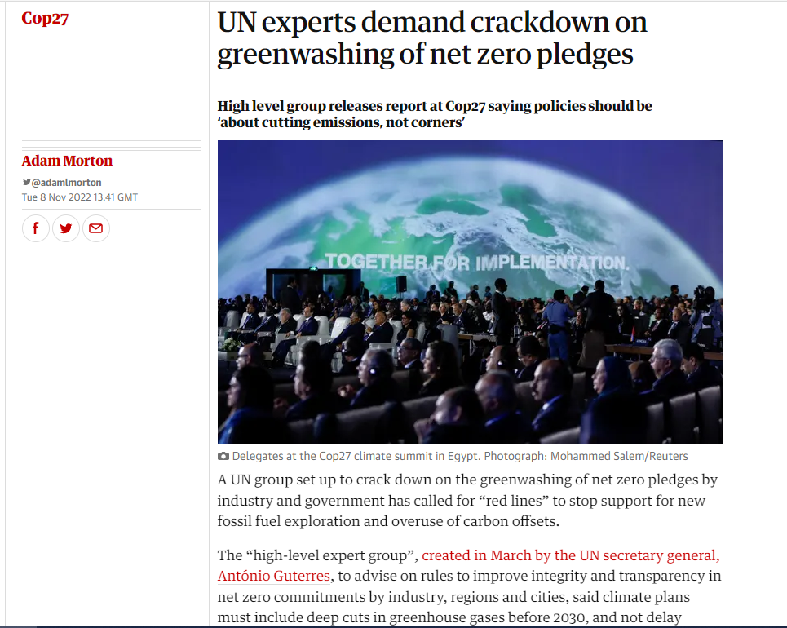
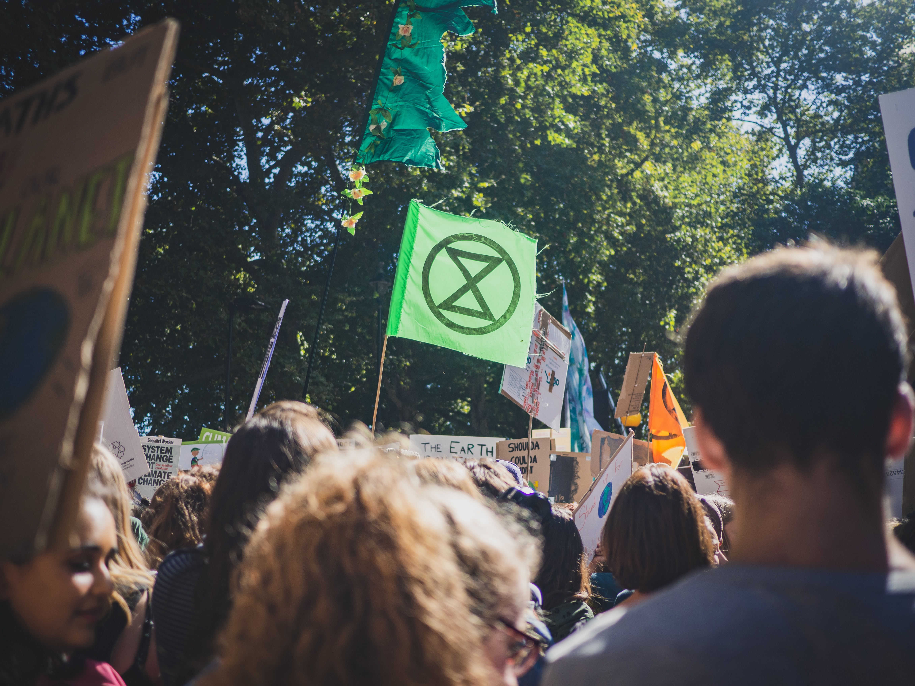
How did we get here?
Photo by Gabriel McCallin on Unsplash

Slide 6
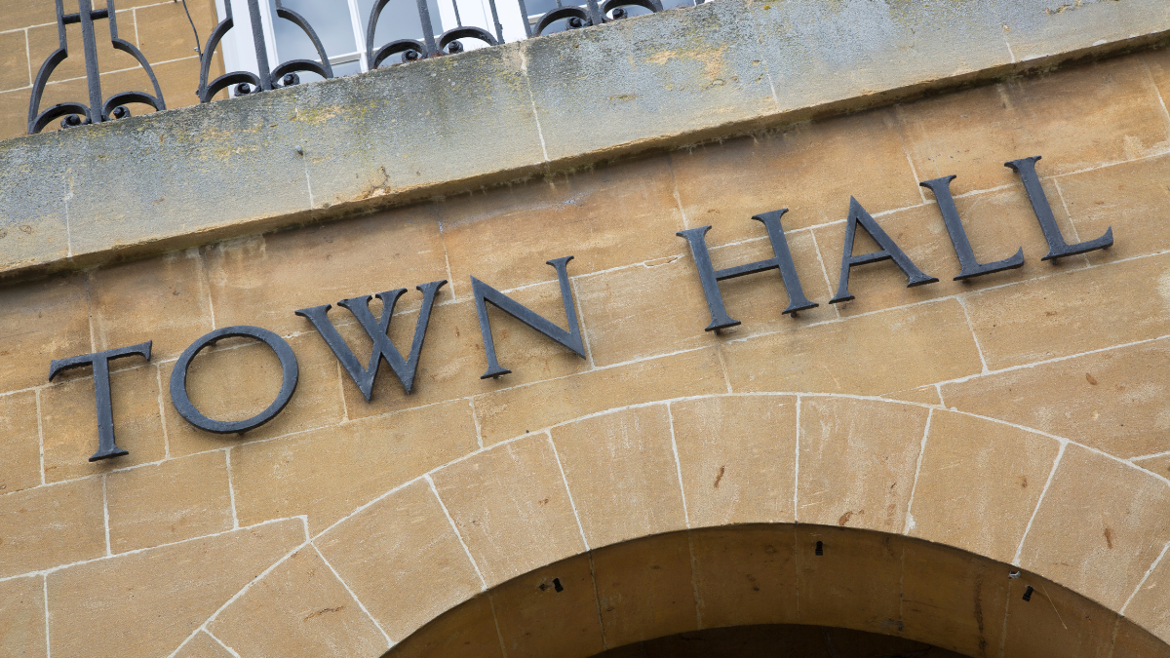
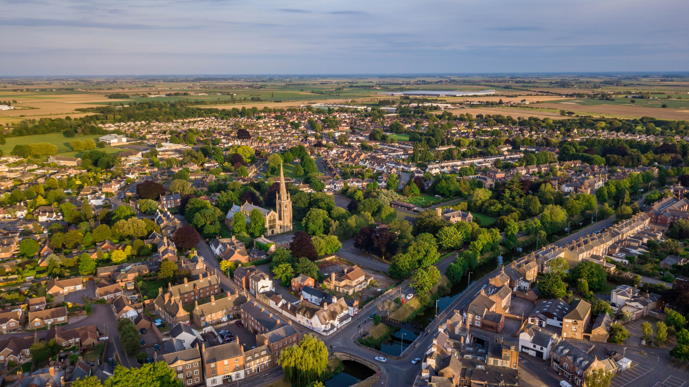

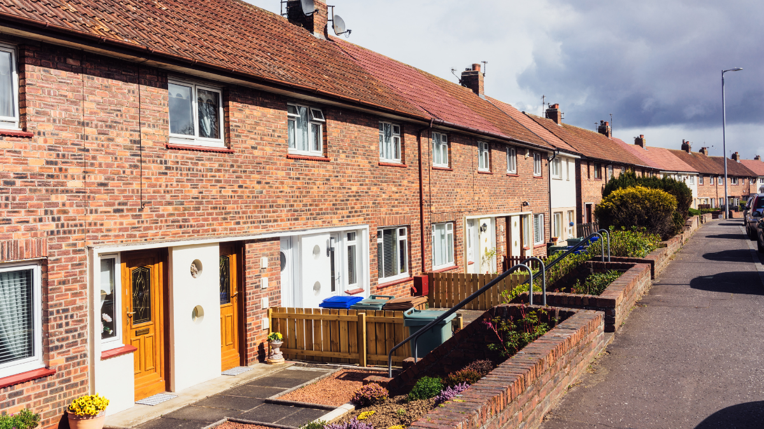
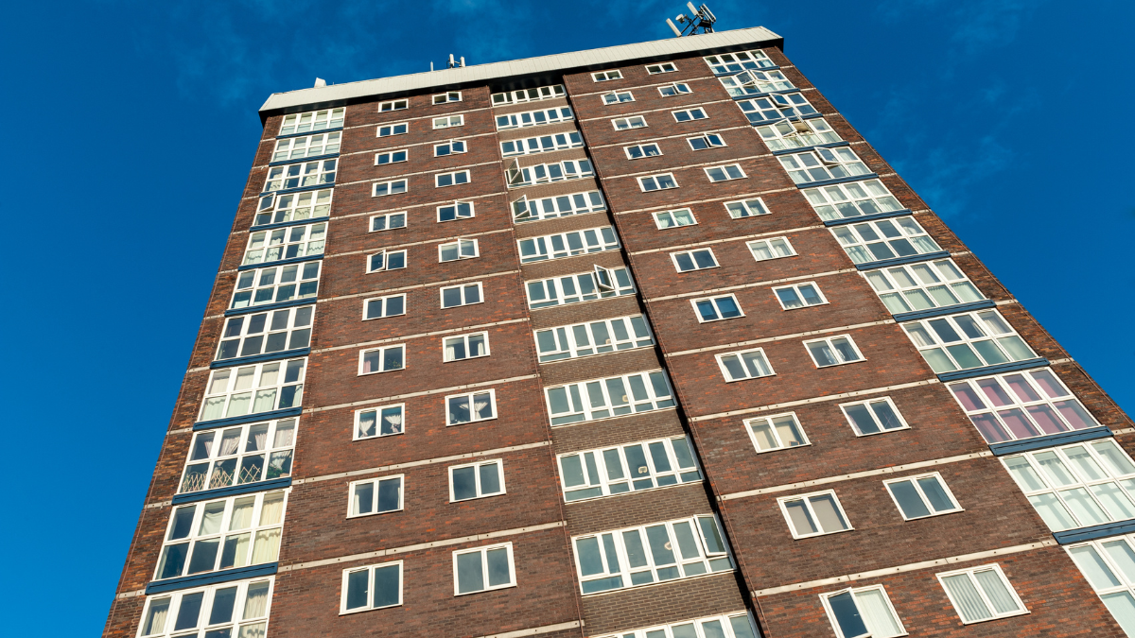
How did we get here?
The Power of Local Change

Slide 7
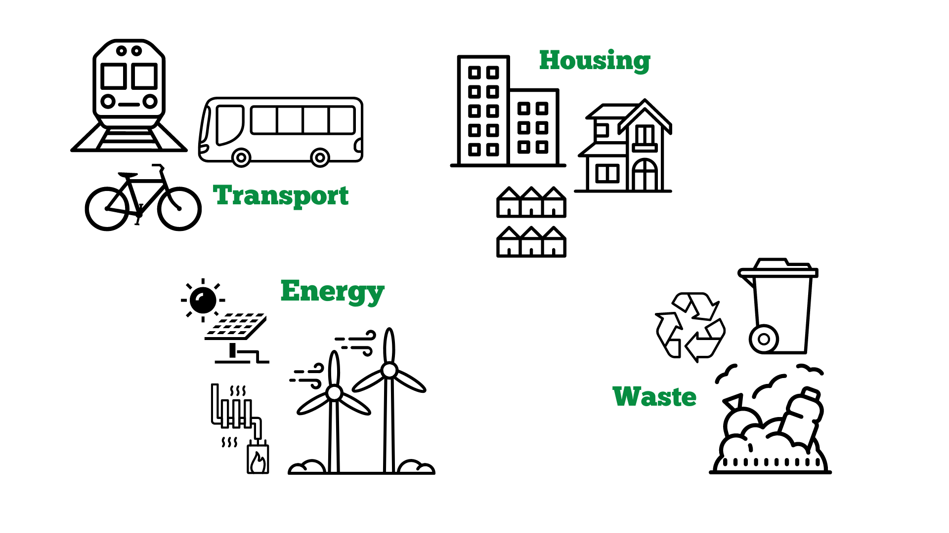
Efficiency of new buildings
Retrofitting old buildings
Insulation and heating systems
Planning and regulation
Mapping the local housing stock
Clean energy infrastructure
Planning policy for new developments
Support community energy organisations
Local public transport plans
Transition to electric vehicle use
Walking and cycling infrastructure
Collection and disposal of household and commercial waste

Slide 8
“How can we make the journey towards net-zero as just, fair and effective as possible?”
85%
of councils have already set a target for reducing their emissions to net-zero.

Slide 9
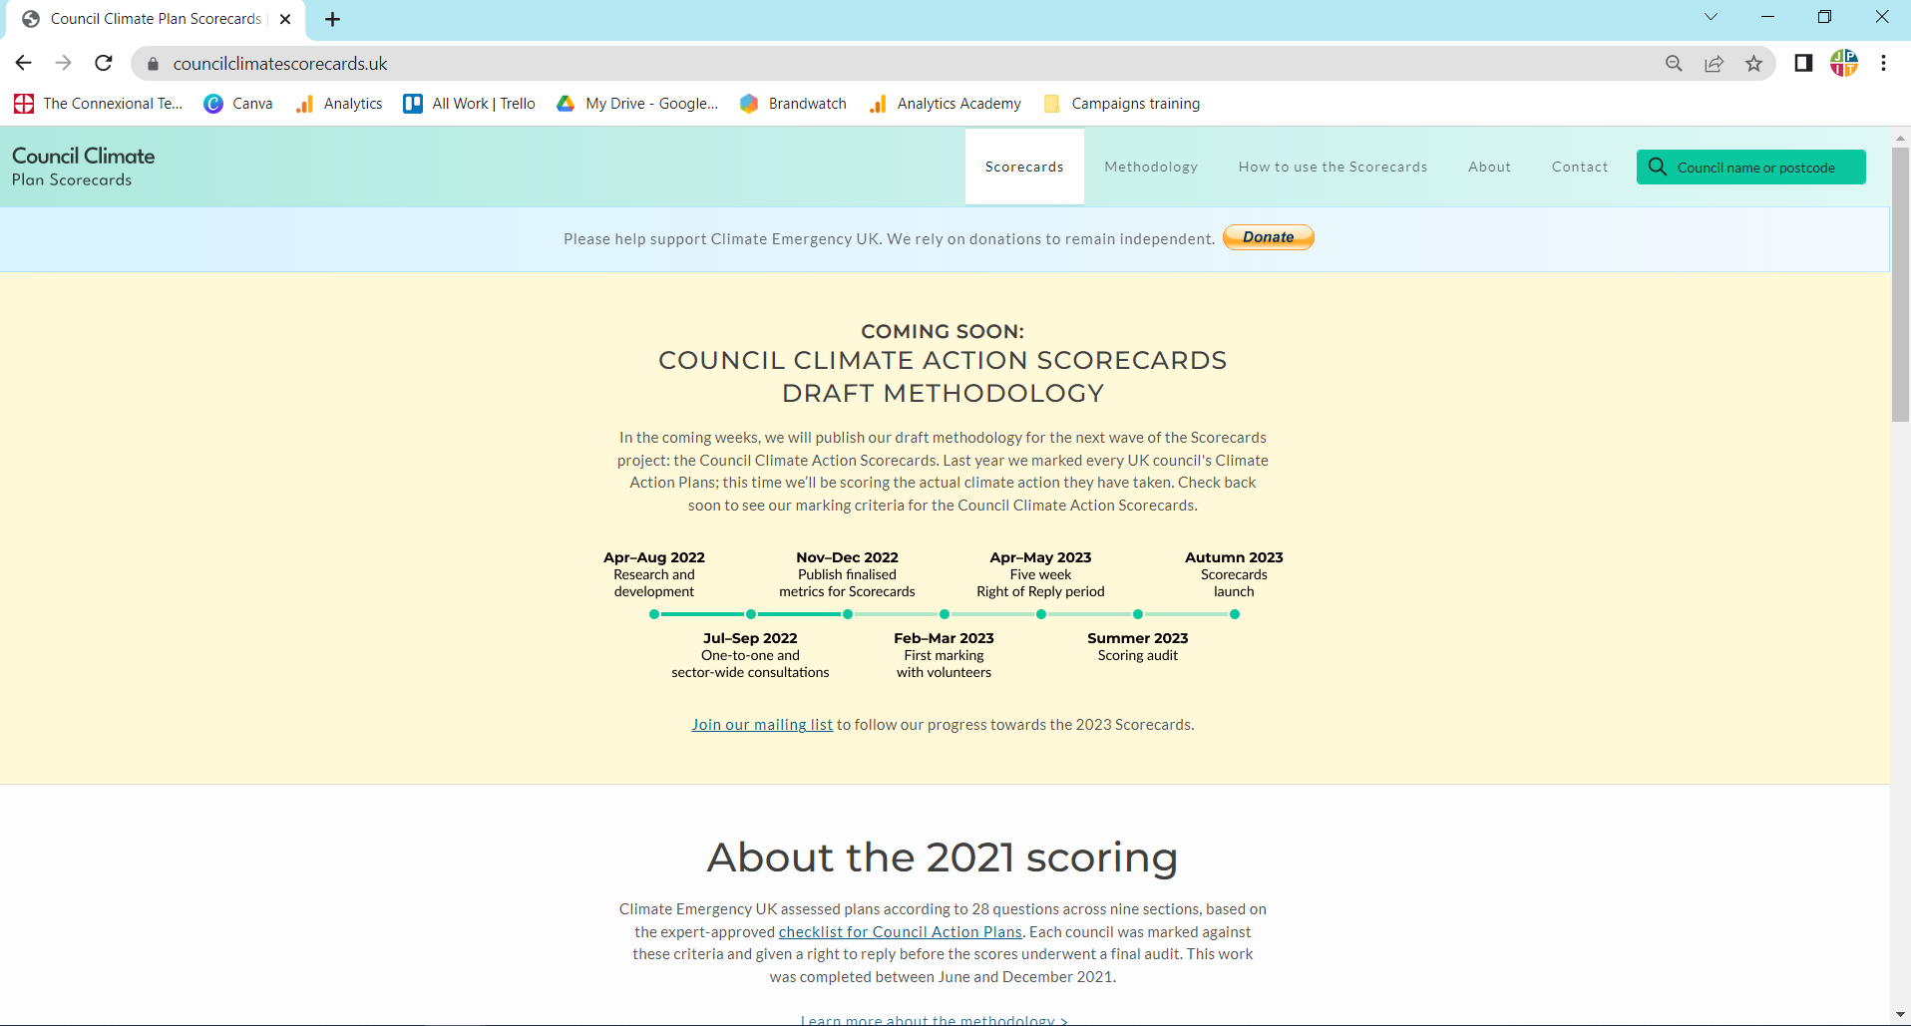

Slide 10

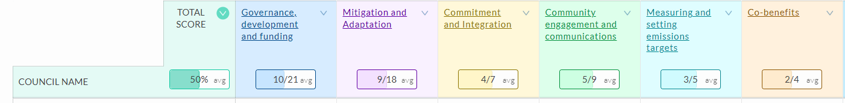
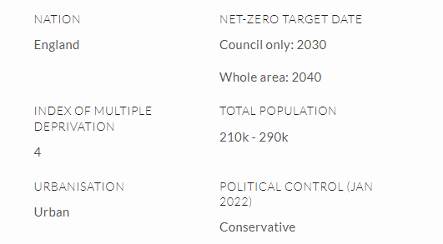
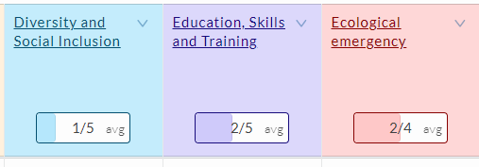


Slide 11
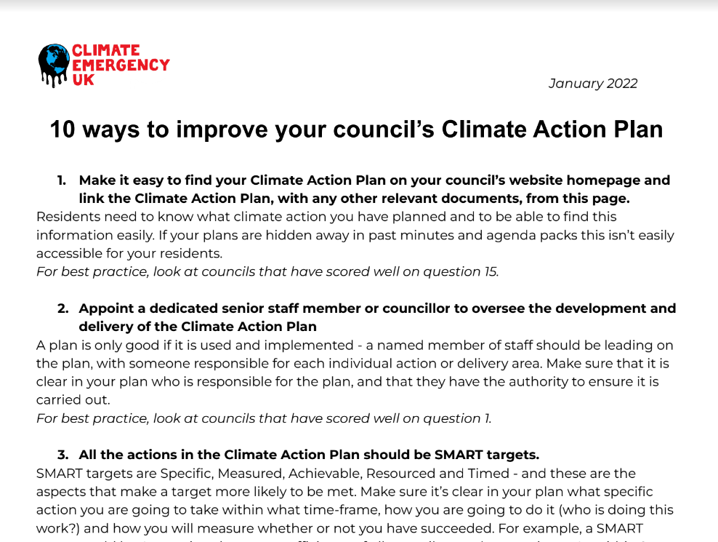
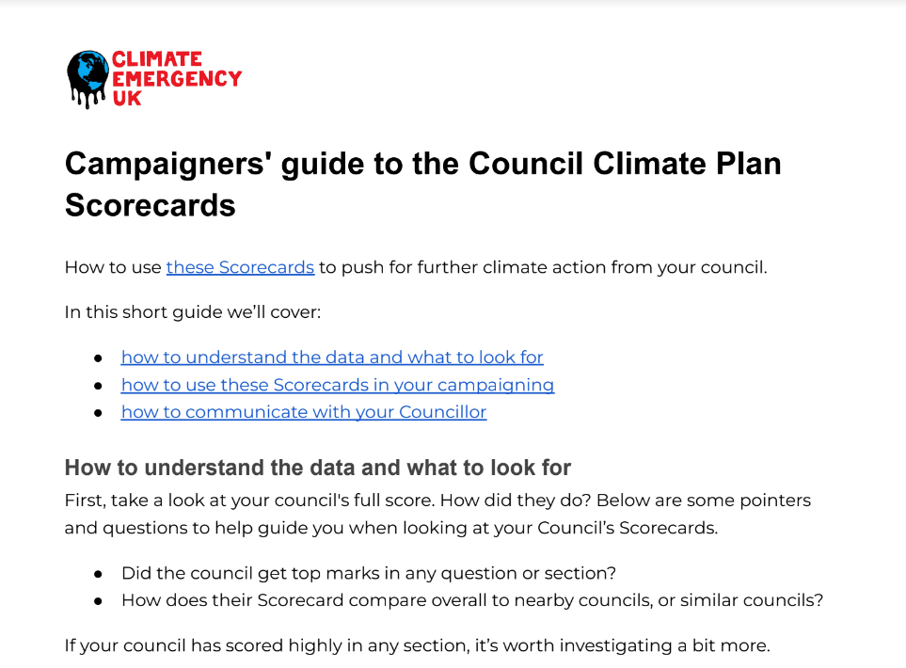
councilclimatescorecards.uk

Slide 12

What are our strengths?

Slide 13
What are our strengths?
What are the abilities and skills we have to bring?
What experiences can we learn from?
What knowledge do we have to move us forward?
What resources can we offer?

Slide 14

Collaboration
Community
Commitment

Slide 15
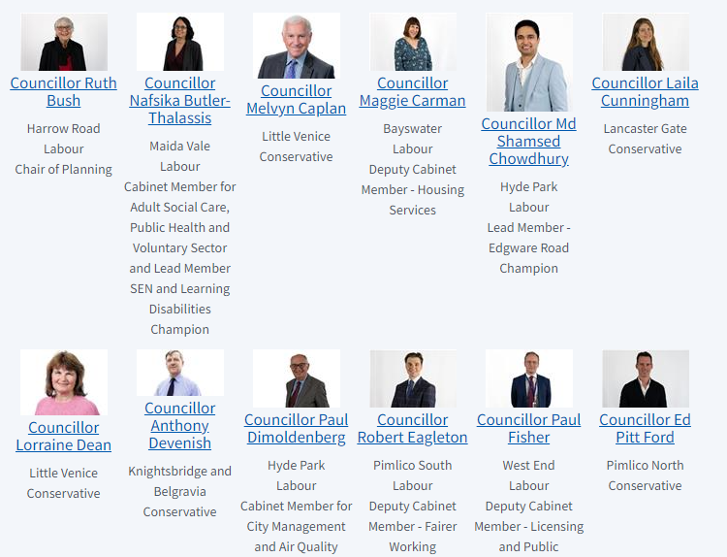
Who are your councillors?

Slide 16
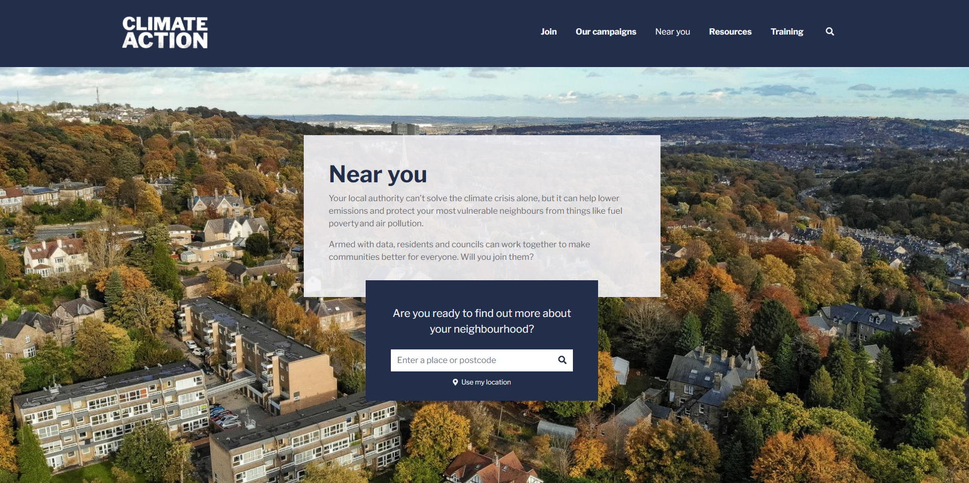
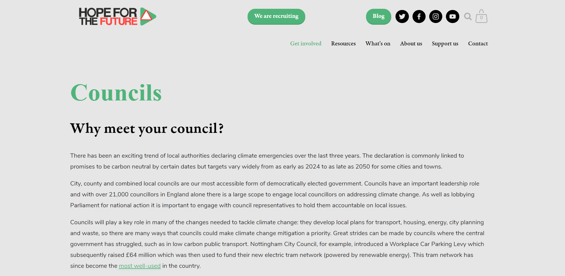
Who could you partner with?

Slide 17
10 Top Tips for Engaging with your Councillor!
Don't assume that your councillor is an expert
Do your research
Form SMART requests (Specific, Measurable, Achievable, Relevant, Time-bound)
Don't ask for something a councillor cannot do
Have a positive, empowering message rather than a negative one
Have a two-way conversation and be ready to take new information on board
Invite them to meet your community
Keep channels of communication open
Scrutinise delivery, hold them to account
Stay in touch with JPIT!

Slide 18
Prayers and Reflections
Who can you pray for?
Where can you pray for?
What can you commit to?

Slide 19
